Slide 1
DRAFT - Metadata Object Model
ION GNSS SDR
Metadata Working Group
September 14, 2014

Slide 2
Overview
Normalized object model of metadata schema based upon meeting results from Sept 10, 2014 at ION GNSS+
UML Model shows the principal object types and relationships.
Generated schema from object model for specification testing.
Created temporary github for all artifacts.
https://github.com/mbmathews/metadata/blob/master/schema/DraftGnssMetadata.xsd
Need to move this to an ION owned GIT.

Slide 3
Changes to proposed schema
Datafile Element (new) – captures specification for a single datafile
Namespace changes
Lump – eliminated since contained within definition of datafile. The number of streams included and stream ordinal attribute specified in the datafile element defines the lump (aka sample word).
Chunk – changed to subframe
Band – changed to channel for generalization in support of intermediate file output. Metadata description can also be used for intermediate output as well.
Various element attribute names expanded to make their meaning more obvious for reader legibility. Goal for xml is legibility and readability.
Schema Changes
Metadata files can include other metadata files allowing referencing of standard elements (e.g. channels, streams, system, etc.)
References to previously defined elements is done by specifying the id. Plan is for referenced elements to be copied into the linked element.
Inclusion (using the include element) of multiple files with references via ‘id’ field make it possible to support all complex multi-file configurations as well as a simplified single-file versions

Slide 4
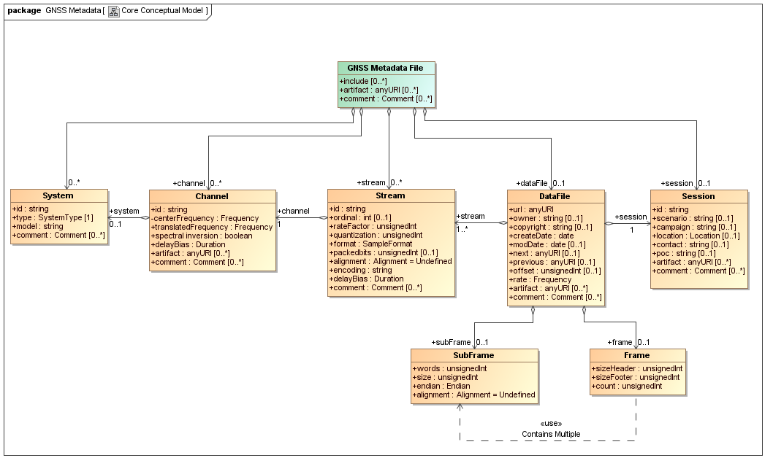
Core Conceptual Model

Slide 5
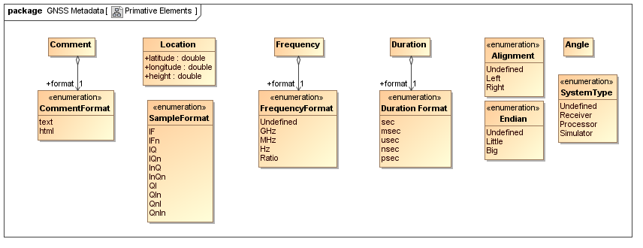
Primative Elements

Slide 6
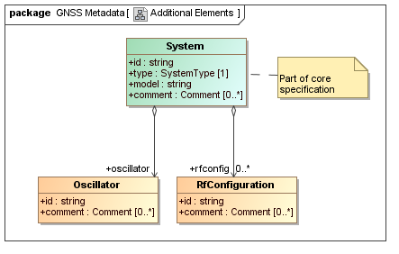
Additional Elements

Slide 7
XML Schema Model
Following figures show the fully specified XML schema.
Generated schema is available at
https://raw.githubusercontent.com/mbmathews/metadata/master/schema/DraftGnssMetadata.xsd
To test the schema and create templates
http://xsd2xml.com
To validate metadata xml using the schema
http://www.freeformatter.com/xml-validator-xsd.html

Slide 8
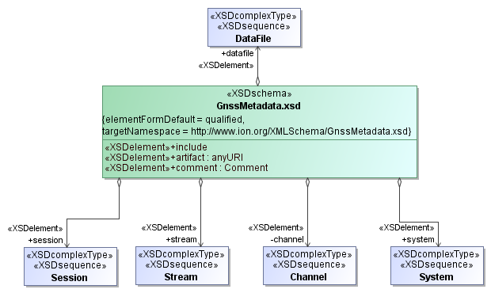
Top-Level Schema

Slide 9
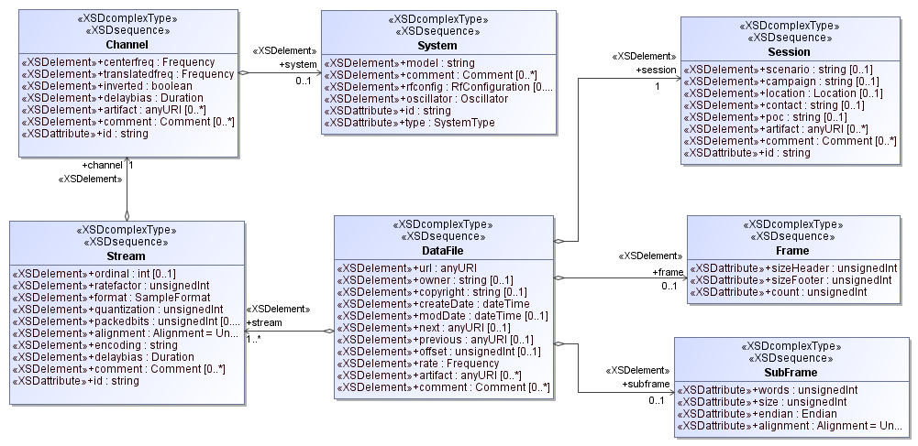
Core Elements

Slide 10
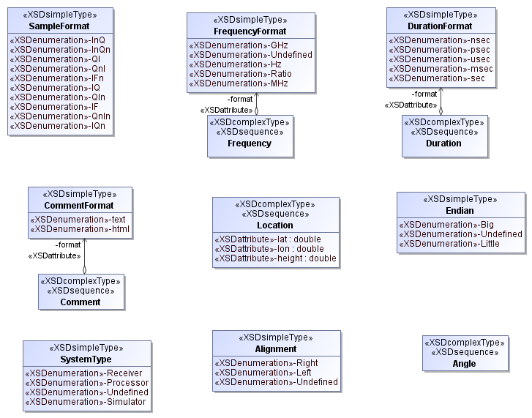
Primative Types

Slide 11
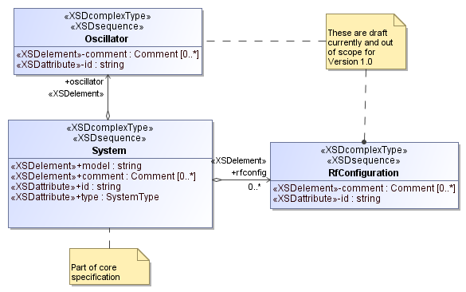
Additional Types

Slide 12
Sample XML Template (Single File)
<?xml version="1.0" encoding="utf-8"?>
<datafile>
<url>sdrdata.bin</url>
<owner>str1234</owner>
<copyright>str1234</copyright>
<stream id="str1234">
<ordinal>123</ordinal>
<ratefactor>123</ratefactor>
<format>InQ</format>
<quantization>123</quantization>
<packedbits>123</packedbits>
<alignment>Right</alignment>
<encoding>str1234</encoding>
<channel id="str1234">
<centerfreq format="GHz" />
<translatedfreq format="GHz" />
<inverted>true</inverted>
<delaybias format="nsec" />
<artifact>http://www.xsd2xml.com</artifact>
<comment format="text" />
<system id="str1234" type="Receiver">
<model>str1234</model>
<comment format="text" />
<rfconfig id="str1234">
<comment format="text" />
</rfconfig>
<oscillator id="str1234">
<comment format="text" />
</oscillator>
</system>
</channel>
<delaybias format="nsec" />
<comment format="text" />
</stream>
<session id="str1234">
<scenario>str1234</scenario>
<campaign>str1234</campaign>
<location lat="3.1415926535" lon="3.1415926535" height="3.1415926535" />
<contact>str1234</contact>
<poc>str1234</poc>
<artifact>http://www.xsd2xml.com</artifact>
<comment format="text" />
</session>
<createDate>2012-12-13T12:12:12</createDate>
<modDate>2012-12-13T12:12:12</modDate>
<next>http://www.xsd2xml.com</next>
<previous>http://www.xsd2xml.com</previous>
<offset>123</offset>
<rate format="GHz" />
<subframe words="123" size="123" endian="Big" alignment="Right" />
<frame sizeHeader="123" sizeFooter="123" count="123" />
<artifact>http://www.xsd2xml.com</artifact>
<comment format="text" />
</datafile>

